Slide 1

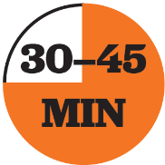


Administering the Diagnostic at Home for Families
Tips for Facilitation:
Plan when you’ll facilitate this presentation.
Review the slides and prepare to facilitate them.
There are detailed facilitation notes and talking points in the “Notes” section of each slide.
Edit any text in red to personalize the presentation for your school or district.
Once you’ve chosen the option you’ll facilitate, consider the following:
What components of the presentation will resonate with my families? These might be components to emphasize.
What adjustments will I make to the presentation?
i-Ready assessments help you better understand students’ strengths and areas for growth, but only when that data is accurate. Use this presentation to help families be as supportive as possible as their student(s) take the Diagnostic at home.
Use one of these three presentation options based on how much time you have to meet with families in advance of students taking the Diagnostic at home.
Presentations Included:
Option 1
Option 2
Option 3

Slide 2


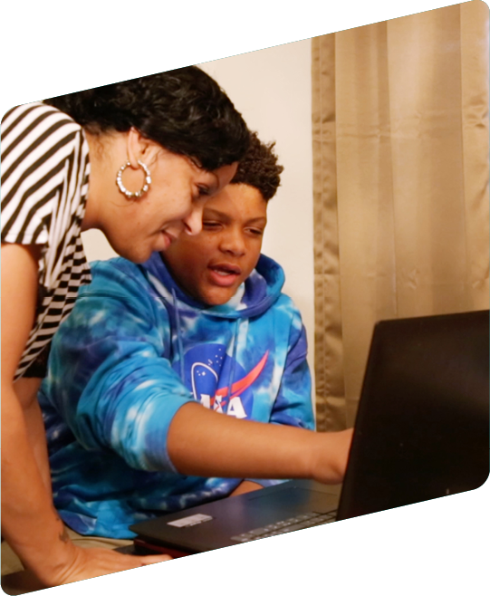


Administering the Diagnostic at Home for Families
Notes:
30- to 45-minute lesson
Welcome and Introductions
Focus of session:
Learn what i-Ready is and how the Diagnostic works
Understand how to support your child before, during, and after taking the Diagnostic assessment
Prepare and motivate students for the Diagnostic to ensure that your data is reliable
Explore resources that families can use to support i-Ready use at home

Slide 3

Agenda
i-Ready Overview
Explain How the Diagnostic Works and How It Can Be Delivered at Home
Explore i-Ready Resources for At-Home Learning
i-Ready Q&A!
Notes:
Share the agenda and edit if needed to align with district and school initiatives

Slide 4








What is i-Ready?
Insight
Goals
Personalized Instruction
Resources
Aspirational, attainable goals for each student to get them
on a path to proficiency or advanced proficiency
Personalized online lessons
based on students’ individual skill levels
Resources for whole class and
small group instruction
Insight into student learning across K–12 skills that
pinpoints students’ strengths and areas of need
Notes:
*This is an animation that will show in full format in slideshow/presenter mode
i-Ready is an online program for reading and mathematics that will help me determine your child’s needs, personalize their learning, and monitor progress throughout the school year.
i-Ready allows me to meet your child exactly where they are and provides data to increase your child’s learning gains.
​
Explain what i-Ready is: ​
i-Ready was built from College and Career Readiness Standards in Reading and Mathematics​
It is a program designed to meet many educator needs; i-Ready connects rich assessment data to personalized digital learning and teacher-led instruction.​
i-Ready has three primary components. ​
i-Ready Assessment:
(Click) Provides comprehensive insight into student learning across K–12 skills and pinpoints students’ strengths and areas of need
(Click) Shows you aspirational, attainable goals for your child to put or keep them on a path to proficiency or advanced proficiency.
i-Ready Learning:
(Click) Engages students through motivating, personalized reading and mathematics instruction based on their individual skill level
The third component is Teacher-Led Instruction:
i-Ready provides your child’s teacher with data to understand student performance and needs, and
(Click) Provides your child’s teacher with resources for whole class and small group instruction to accelerate student growth and grade-level learning
Alternative video: https://share.vidyard.com/watch/CdGRnjBuu3jUSxcE4Aiid4

Slide 5
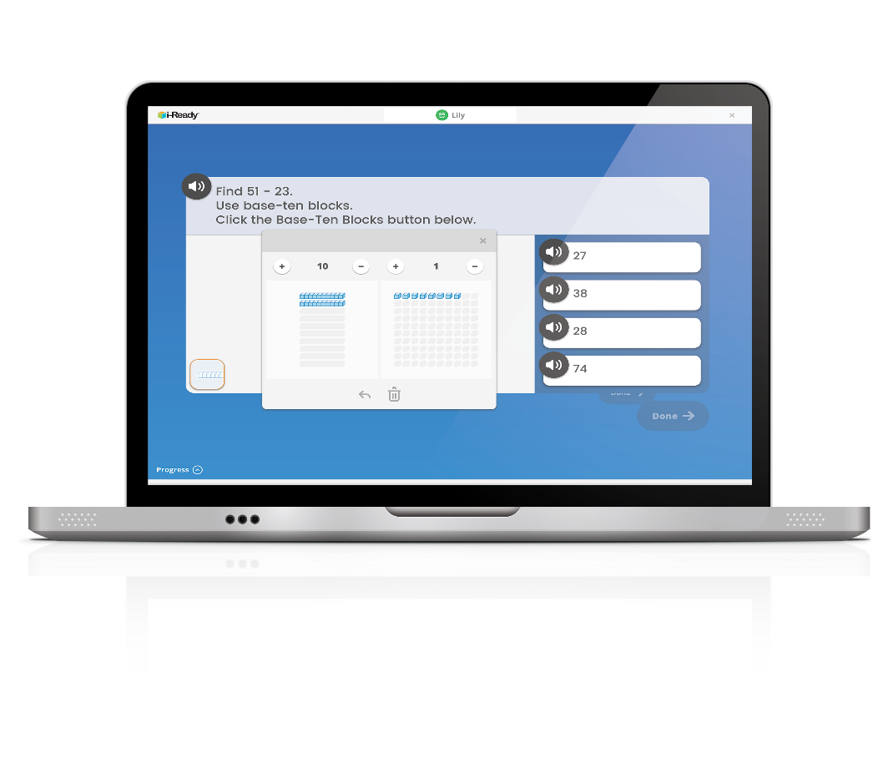
i-Ready Diagnostic
The i-Ready Diagnostic is an adaptive assessment that adjusts its questions to suit your student’s needs. Each item a student sees is individualized based on their answer to the previous question.
The purpose of the Diagnostic is not to give your student a score or grade, but instead to determine how best to support your student’s learning.
Notes:
Review slide and transition to how the Diagnostic works.
*Consider adding additional talking points to reflect how your district or school uses i-Ready.

Slide 6
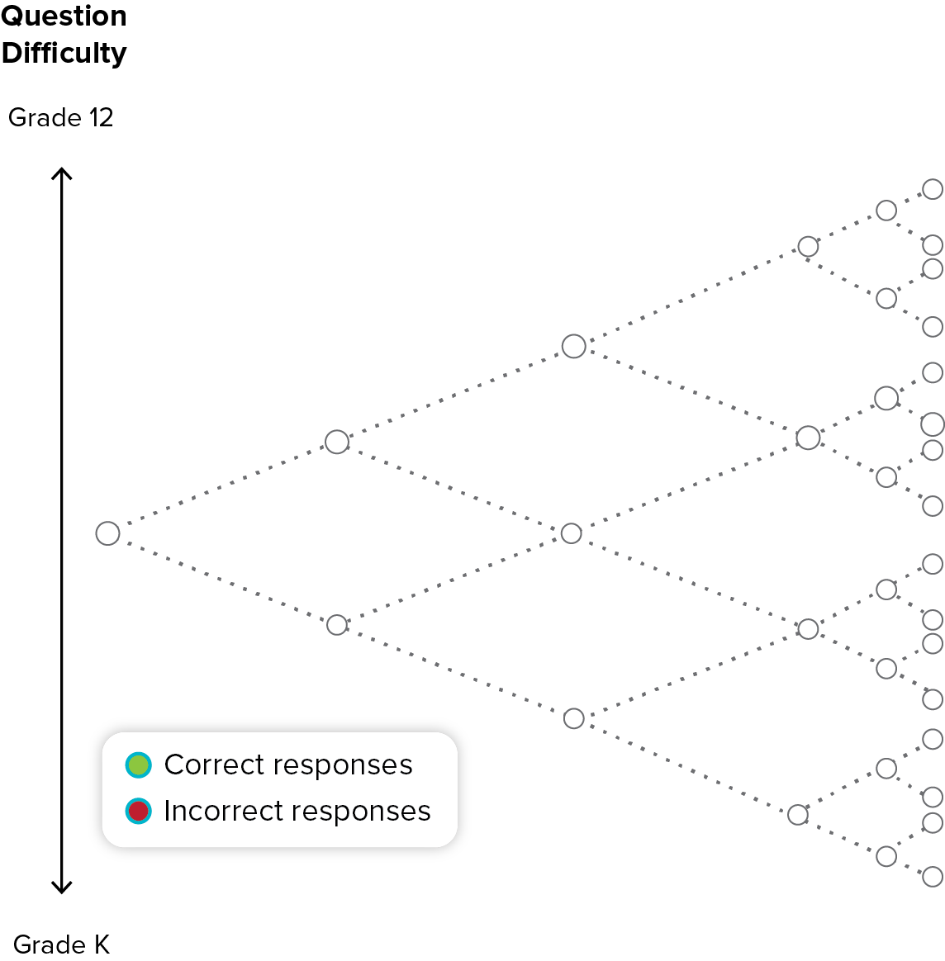


Adaptive Diagnostic Assessment
Actual
Performance
Level
Notes:
(Click) Students begin the first Diagnostic with an item one grade level below their actual grade​
(Click) As students answer correctly or incorrectly, the Diagnostic adapts to more challenging or less challenging items​
(Click) The Diagnostic continues to adapt based on the student’s responses ​
They will get about 50% of items correct and 50% incorrect​
i-Ready generates an overall performance level for each student in reading and in math.
The information the Diagnostic gathers from this process allows i-Ready to pinpoint where and why students are struggling. ​
This helps your child’s teacher provide instruction that is just right for your child!

Slide 7



How Does the Diagnostic Work?
i-Ready is an adaptive test. This means the questions change based on your answers.
Some questions will be . . .
Hard
Easy
Just Right!
Notes:
(Click) In other words, and as you can see from the presentation some of your students have received from their teachers, some questions will be hard, some will be easy, and some will be just right for your child, helping us to gather the information we need to target their needs!

Slide 8
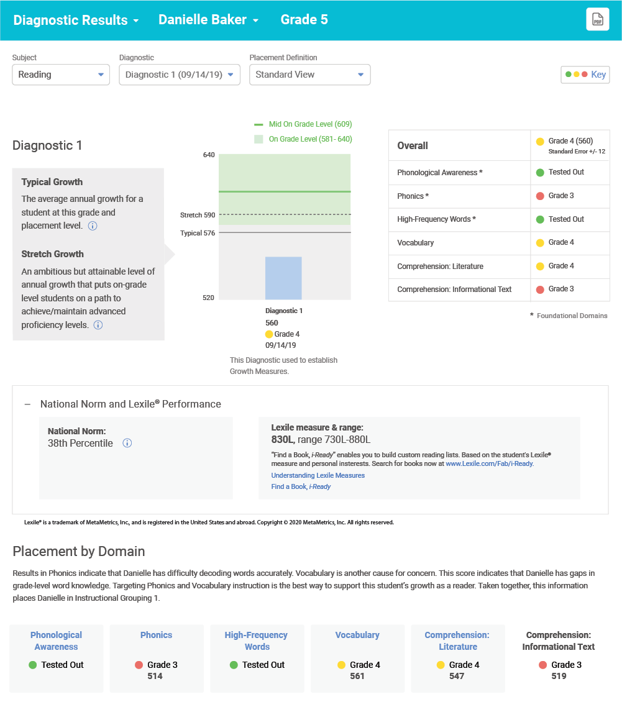
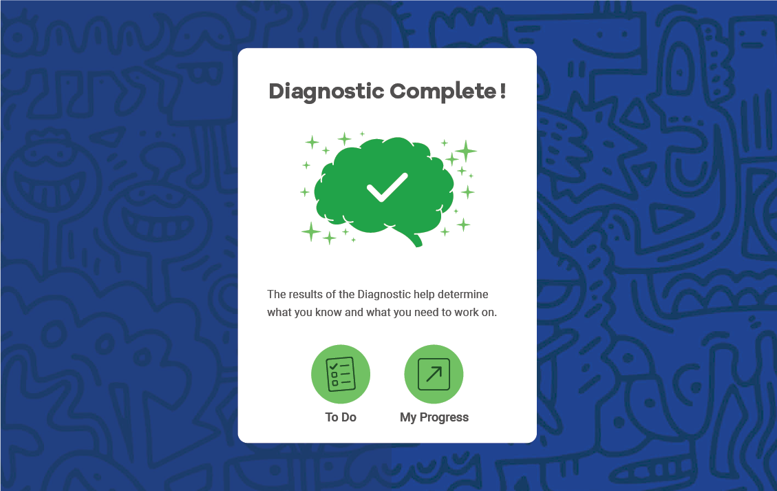
Notes:
When students complete the Diagnostic (Grades 3–8) will see this screen, providing them with their scale score and allowing them to move directly into their Personalized Instruction
Click: note that teachers will receive detailed reports that help them understand your child’s learning strengths and needs and will help keep them connected to your child’s learning no matter the school environment (virtual/in-person/blended)
We’ll review the data in more detail after the Diagnostic with data chats (recommended best practice)

Slide 9


Before the
Assessment
Notes:
In this section, we’ll cover all the ways you can prepare for the assessment before it begins to ensure a smooth test-taking experience.
Drop the link to the Family Guide in the chat at this point: https://i-readycentral.com/pdfs/family-guide/

Slide 10
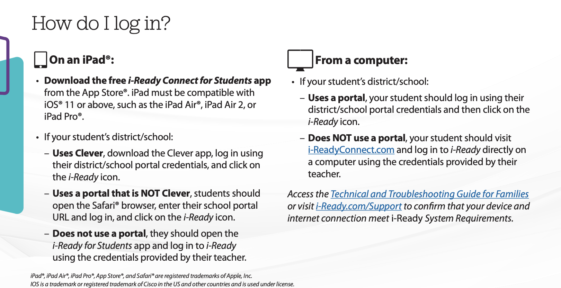
Logging In
Notes:
Stress the need to check login credentials and device before trying to take the test.
If time allows, please also go live to i-Ready.com/Support or drop the link in the chat.
If you go live, please also guide families to the Technical and Troubleshooting Guide for Families.
Technical and Troubleshooting Guide for Families (English): https://i-readycentral.com/pdfs/technical-and-troubleshooting-guide-for-families/
Technical and Troubleshooting Guide for Families (Spanish): https://i-readycentral.com/pdfs/technical-and-troubleshooting-guide-for-families-spanish/
Family Guide (English): https://i-readycentral.com/pdfs/family-guide/
Family Guide (Spanish): https://i-readycentral.com/pdfs/parent-guide-spanish/

Slide 11



Prepare for the Assessment
Select the Right Time
The assessment typically takes between 45–60 minutes. Break into smaller 15- to 20-minute sessions.
Select the Right Place
Students should take the test in a private and quiet location ideally away from any distractions. Headphones or adequate audio access are recommended for help with focus.
Gather Supplies
Though the test is online, students will need paper and pencil to take notes.
Notes:
Please check with your district or school administrator for any specific or further guidance about testing at home: any red text should be updated to reflect district or school guidance.
When you discuss selecting the right time, note that the test will remember where students left off.
You can drop the link to the Family Center in the chat for more information (we also go there later in the session if you need to move forward)
https://www.curriculumassociates.com/teaching-learning-2020/home-assessment-family-support)

Slide 12
Prepare for the Assessment
Answer the Ws
“Why am I taking this test?”
We are taking the Diagnostic so your teachers know what you can already do and what skills you need!
Notes:
Note to families that their child’s teacher may have already facilitated some preparation for students re: the Diagnostic.
This could be done interactively with parents placing answers in the chat. Alternatively, you could click forward to share our thinking.
Frame as questions the teacher is answering for students but wants the family to know how they’re answering as well.

Slide 13
Prepare for the Assessment
Answer the Ws
“Why is it important to do my best?”
We want to make sure you get lessons that keep YOU learning and growing. We want to make sure you get lessons that aren’t too hard or boring.
Notes:
This could be done interactively with parents placing answers in the chat. Alternatively, you could click forward to share our thinking.

Slide 14
Prepare for the Assessment
Answer the Ws
“What is the test like?”
  The test adapts, or changes, as you take it. That means some questions might be hard and some may be easier. You’ll probably get about half of the questions right—that means the test is working perfectly! Remember, you won’t be graded or get a score. Once you’re finished, your teacher will know how to help you grow!
Notes:
This could be done interactively with parents placing answers in the chat. Alternatively, you could click forward to share our thinking.
When reviewing the question, “What is the test like?,” also point out that students will see a video before the test starts that helps them understand the test.

Slide 15
Prepare for the Assessment
Answer the Ws
“What if I don’t know the answer?”
  Try your best! Remember some questions are going to be hard and it’s okay if you don’t know the answer! Select the answer you think is best and keep on moving!
Notes:
This could be done interactively with parents placing answers in the chat. Alternatively, you could click forward to share our thinking.

Slide 16

During the
Assessment

Slide 17

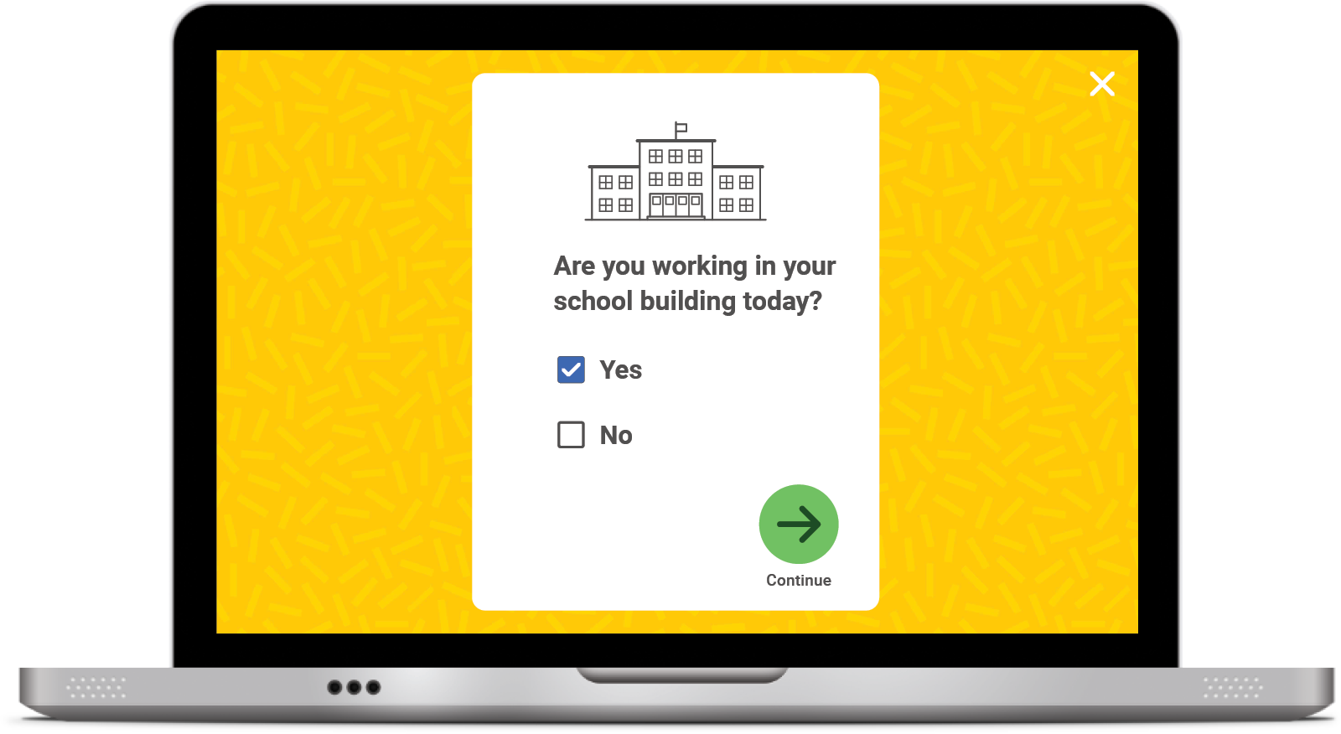
Student Survey
Once you START or RESUME your Diagnostic, you will see this question pop up on your screen:
Click No if you are taking the Diagnostic at HOME.
Click Yes if you are taking the Diagnostic at SCHOOL.
Click the green arrow to move on.
Notes:
Students will be getting a student survey before they take the test.
This image is a sample of the K–2 dashboard, but the same will be true for all Grades K–8.
Are you taking this at school or home?

Slide 18
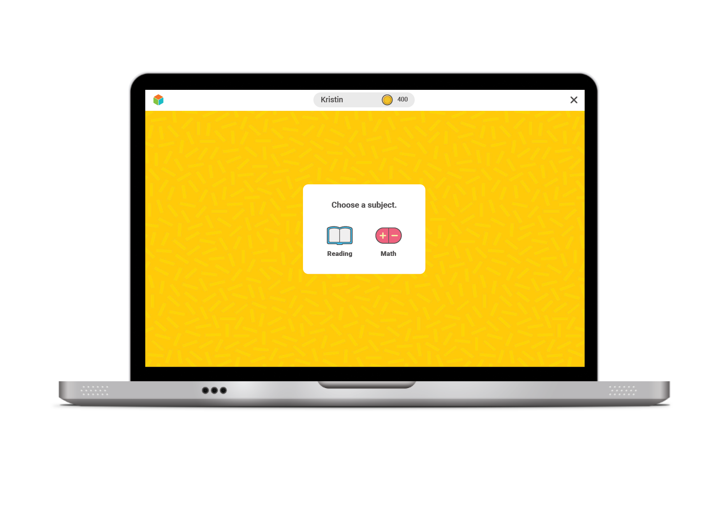

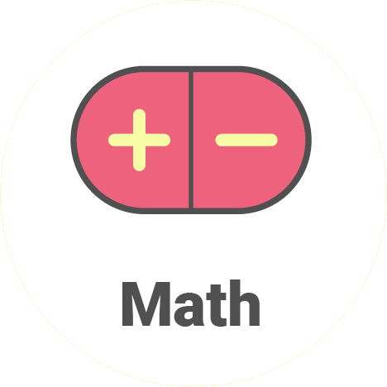
The Student Experience
For Reading,
click on the book.
For Math, click on the math signs.
Notes:
Select Reading or Math to continue.

Slide 19
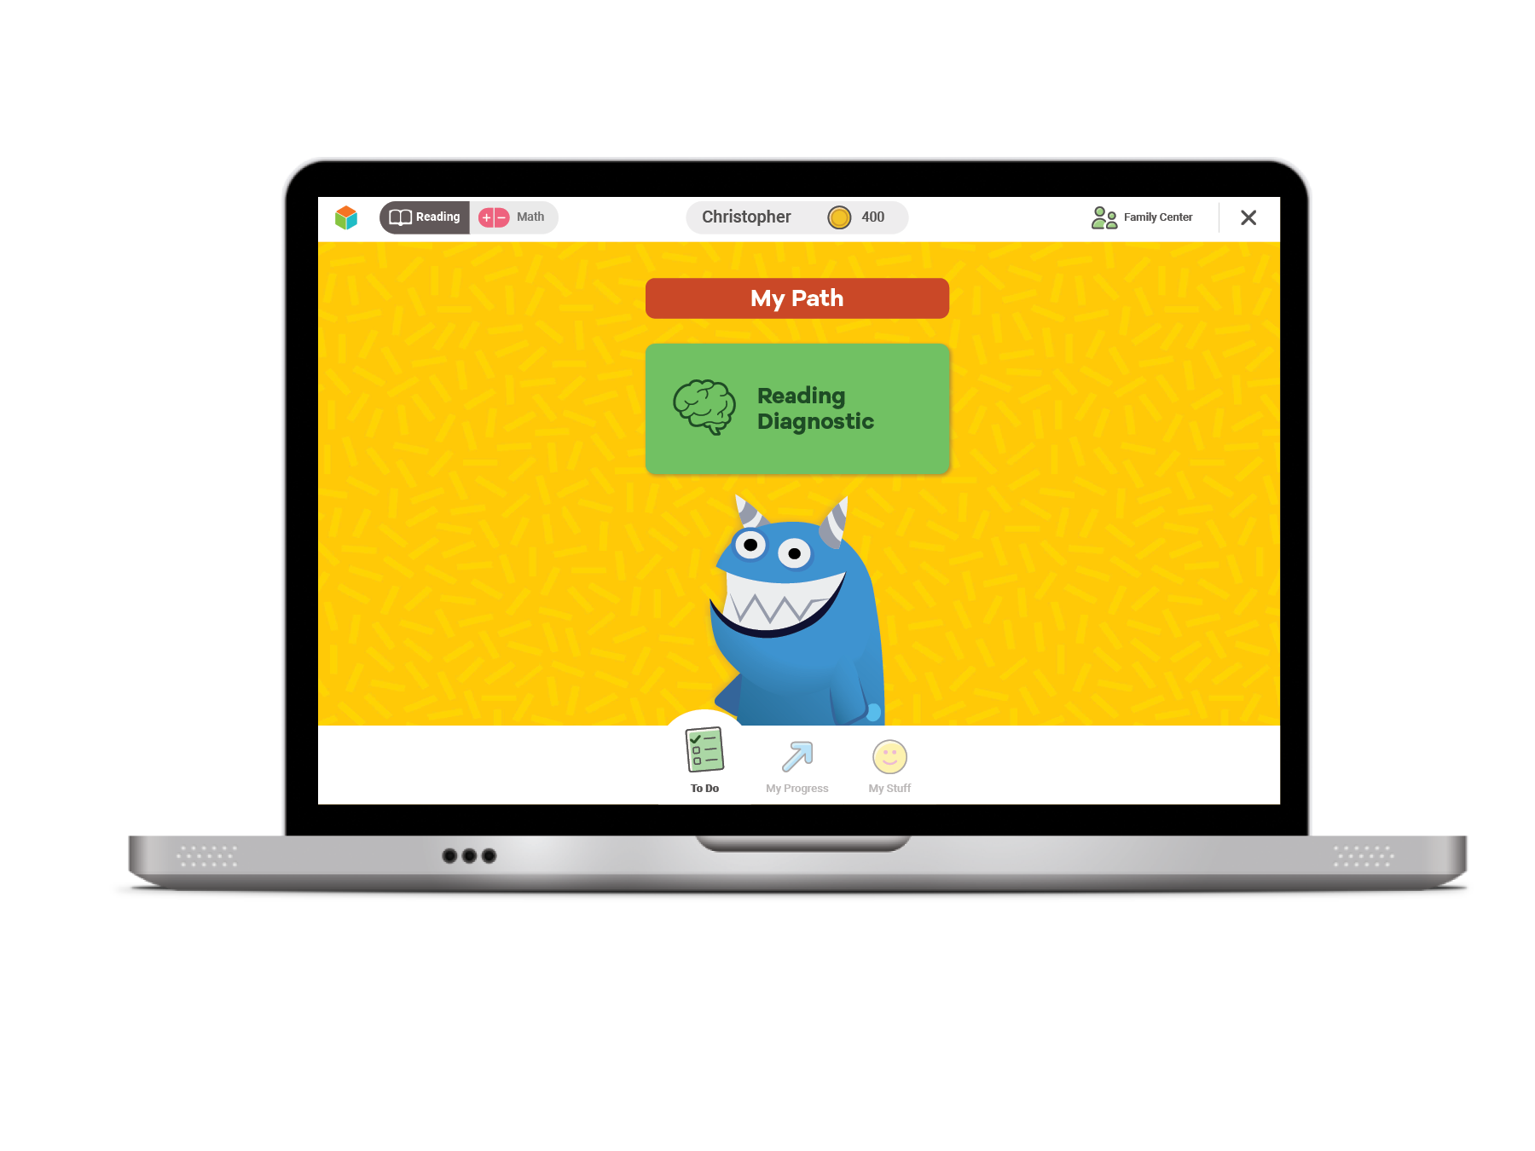
The Student Experience
Click the green button to start your Diagnostic.
Notes:
Select the Diagnostic in the subject that is showing on your student’s screen.

Slide 20
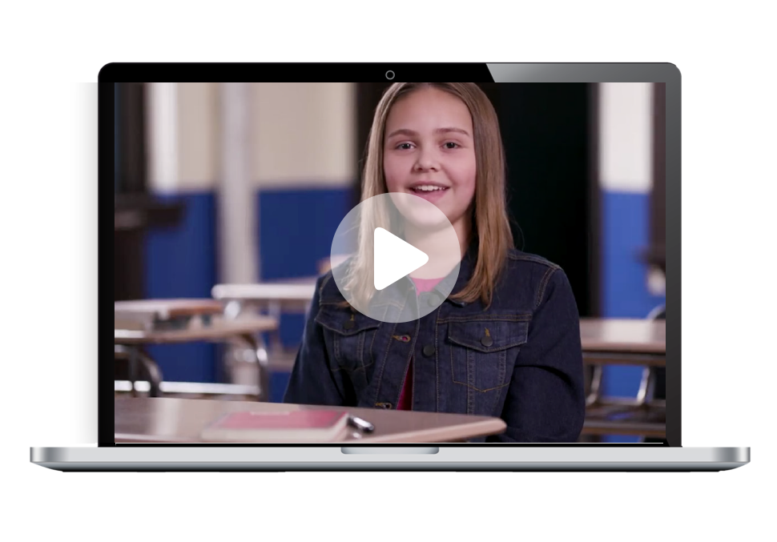
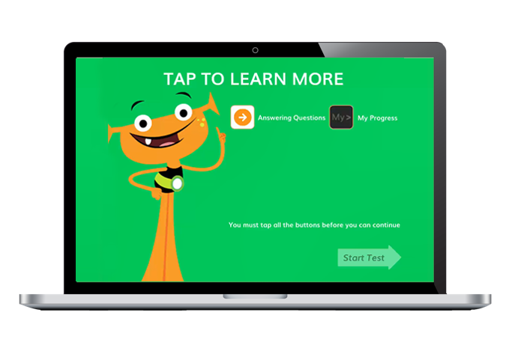
The Student Experience
Click on each button
to watch a video
about each tool.
Watch a video.
You must click on all of them before you can press start.
Notes:
*This is an animation that will show in full form in slideshow/presenter mode.

Slide 21

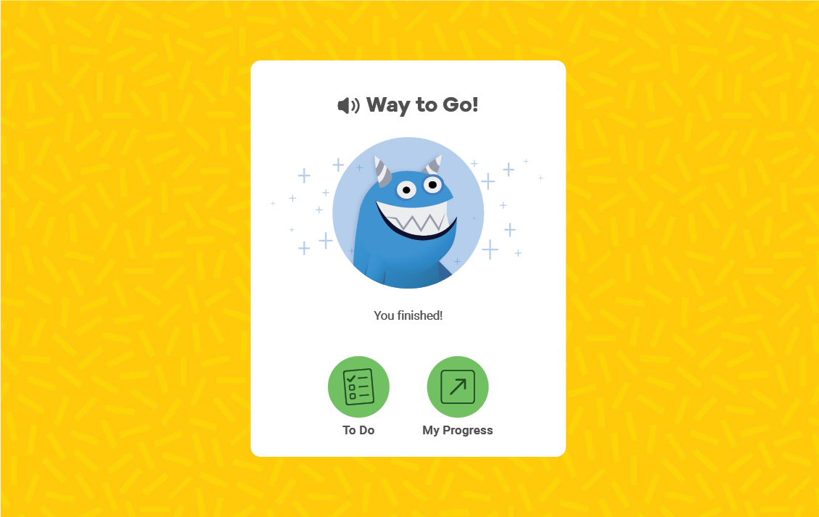
Grades K–2 Confirmation Screen
Notes:
(Grades K–2) Your student will receive a congratulatory message once the test is completed AND lessons will appear on their screen. If there is any question as to whether the student has fully completed the assessment, confirm with the student’s teacher. Make sure your student logs off his/her account once he/she is done.

Slide 22
Grades 3–8 Confirmation Screen
Notes:
(Grades 3–8) Your student will receive a congratulatory message once the test is completed AND lessons will appear on their screen. If there is any question as to whether the student has fully completed the assessment, confirm with the student’s teacher. Make sure your student logs off his/her account once he/she is done.

Slide 23



Effectively Monitor the Diagnostic
Make sure your student is using their paper to take notes and show their work.
If your student seems tired or is getting frustrated, let them take a break! The test will remember where they left off.
Most importantly . . .
Notes:
Frame this slide by reviewing: we want the best data we can get.
Also note when reviewing the tip to allow your child to take a break, that the test has built-in brain breaks for students when they finish questions within a domain.
Please refer to page 3 of this resource for Proctoring Assessments Remotely: https://i-readycentral.com/pdfs/proctoring-assessments-remotely/

Slide 24
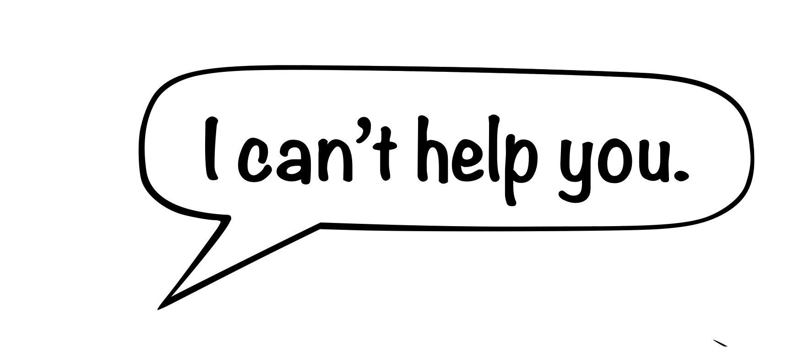

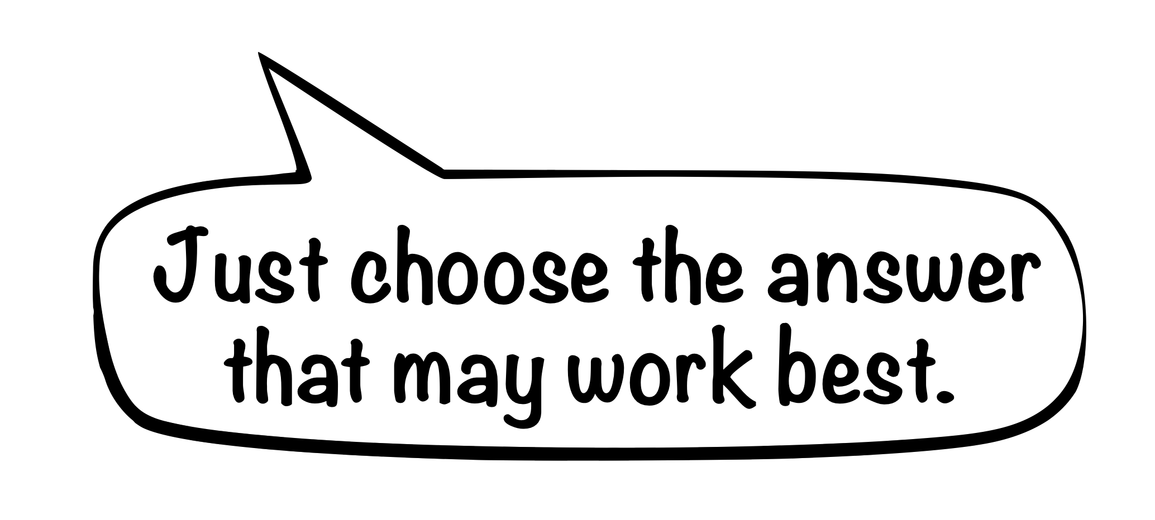
Effectively Monitor the Diagnostic
Don’t help your student answer any questions!
We want the best data possible so your student’s teacher can provide instruction that is just right for them.
Notes:
If you help them on the assessment, they may get lessons that don’t meet their needs and hurt their long-term achievement.
“Help” looks like: reading the passage to a student (unless otherwise specific in a 504 or IEP), giving students alternative strategies for solving a problem when they’re stuck, giving them an answer, etc.

Slide 25

After the
Assessment
Notes:
Once your child has completed the Diagnostic, they’ll receive an individual online instruction path and their teachers will receive targeted and detailed data that will help them to provide your child lessons that are just right for them.

Slide 26
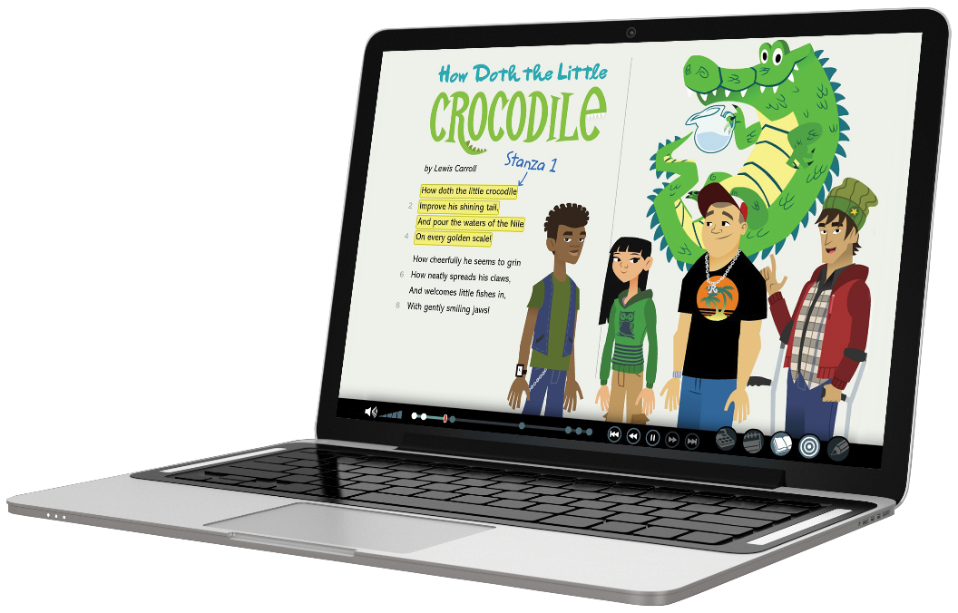
i-Ready Personalized Instruction
i-Ready Personalized Instruction provides students with lessons based on their individual skill level and needs, so they can learn at a pace that is just right for them. These lessons are fun and interactive to keep your student engaged as they learn.
Notes:
Talking Points
i-Ready Personalized Instruction provides all students with personalized digital support.
Our Personalized Instruction delivers powerful online lessons with
Real, quality instruction built from the College and Career Readiness Standards
i-Ready Personalized Instruction is driven by insights from the i-Ready Diagnostic and
Delivers personalized instruction plans to meet each student where they are
i-Ready Personalized Instruction provides automated, differentiated instruction to
Motivate students on their paths to proficiency and growth
Finally, it complements teacher-led instruction which
Allows teachers to target specific skills when students are struggling or need enrichment and challenge

Slide 27
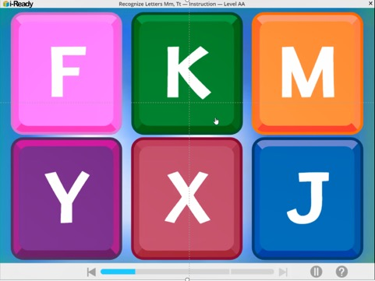
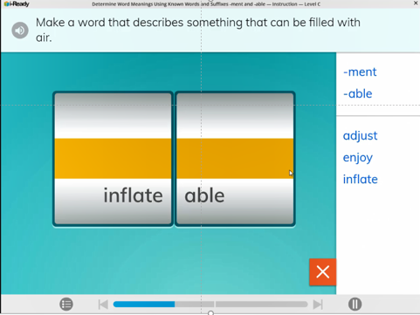
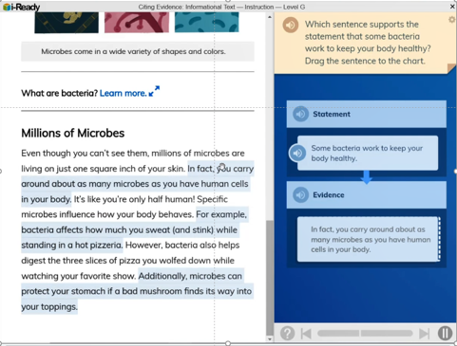
i-Ready Online Lessons for Reading
Emerging K – Phonics:
Recognize Letters Mm, Tt
Grade 3 – Vocabulary:
Determine Word Meanings
Grade 7 – Reading Comprehension:
Citing Evidence: Informational Text
Notes:
Talking Points
i-Ready Online Lessons for Reading:
Incorporate design principles
Are engaging and research-based
Provide access to rigorous differentiated and grade-level content that meets the needs of all learners

Slide 28
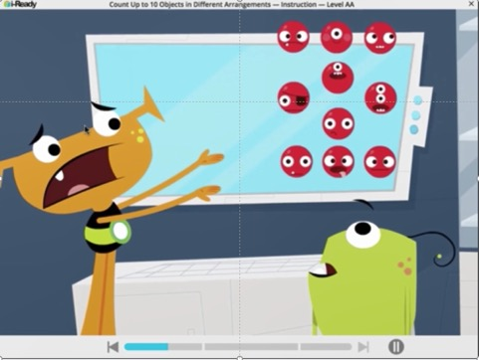
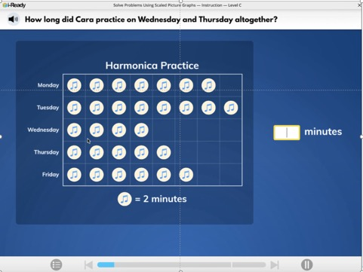
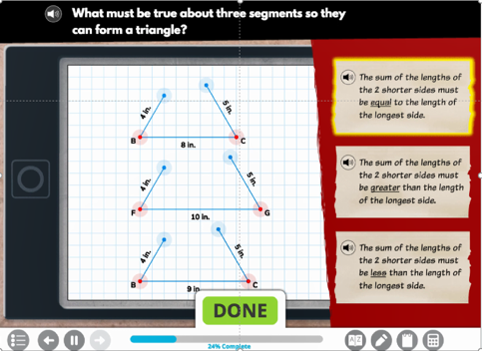
i-Ready Online Lessons for Mathematics
Grade K – Number and Operations:
Count Up to 10 Objects in Different Arrangements
Grade 3 – Measurement and Data:
Solve Problems Using Scaled Picture Graphs
Grade 7 – Geometry:
Construction of Triangles
Notes:
Talking Points
i-Ready Online Lessons for Mathematics:
Incorporate design principles
Are engaging and research-based
Provide access to rigorous differentiated and grade-level content that meets the needs of all learners

Slide 29
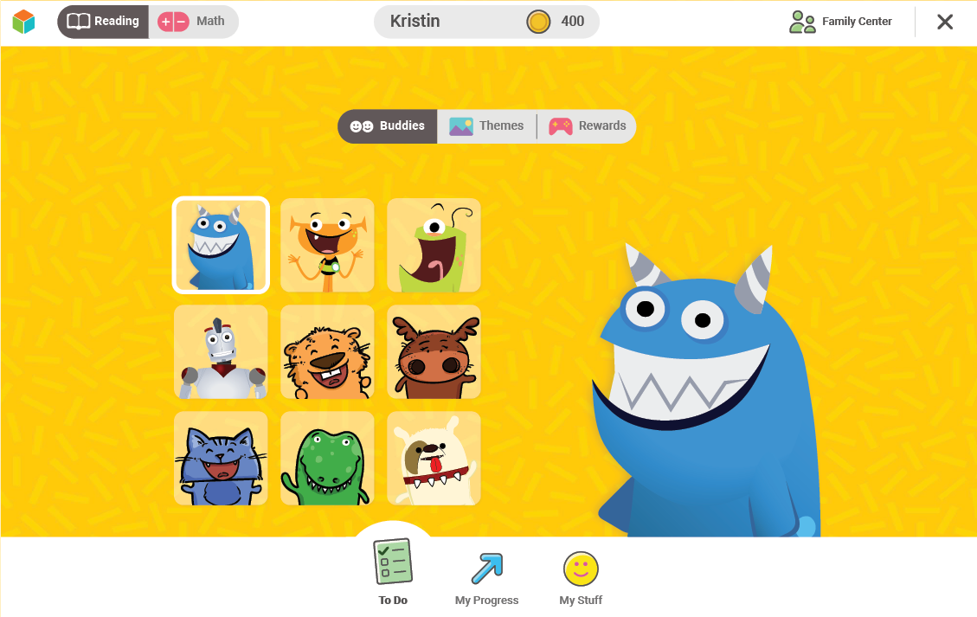
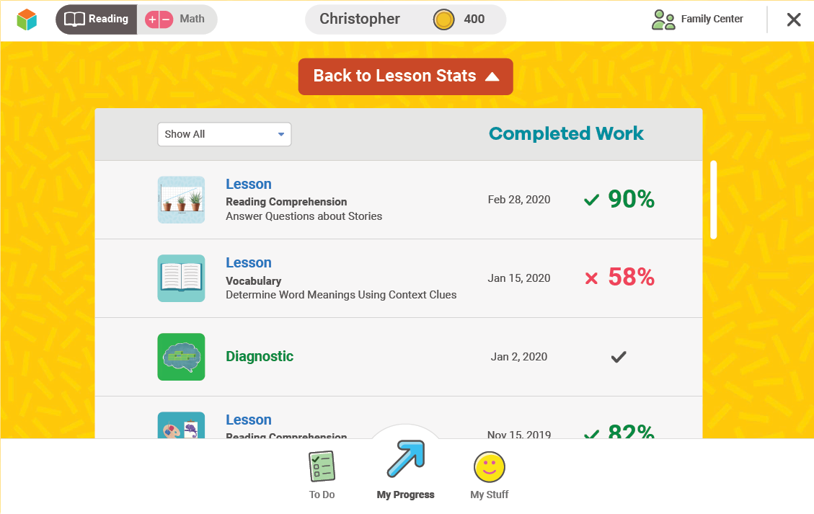
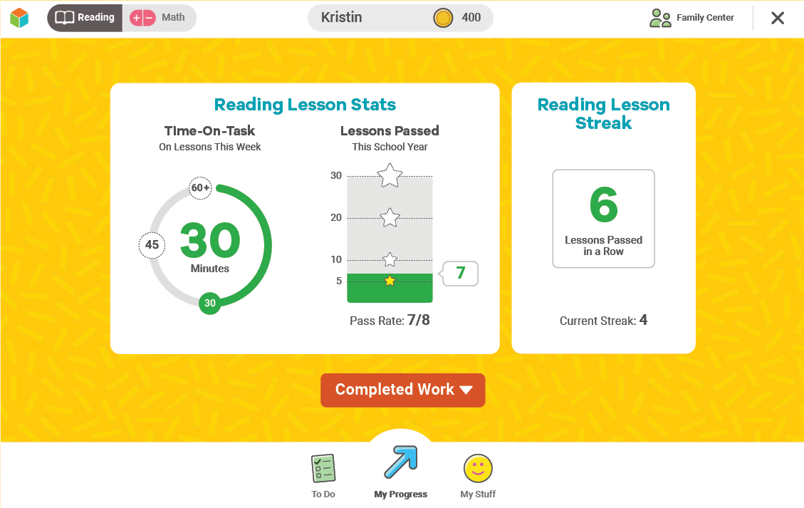
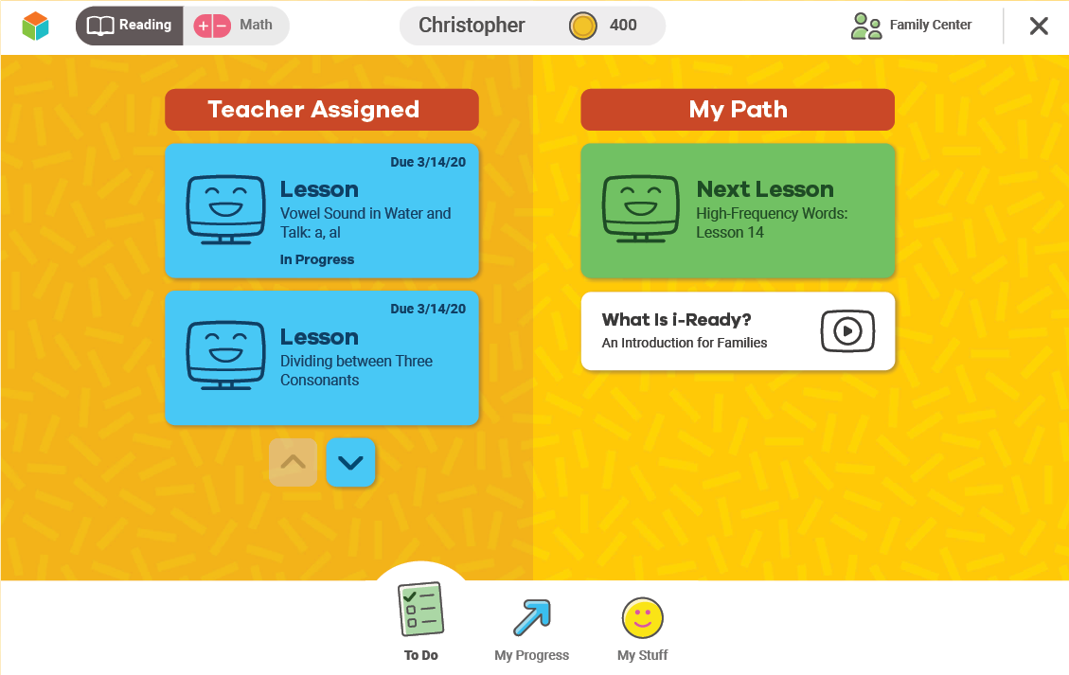
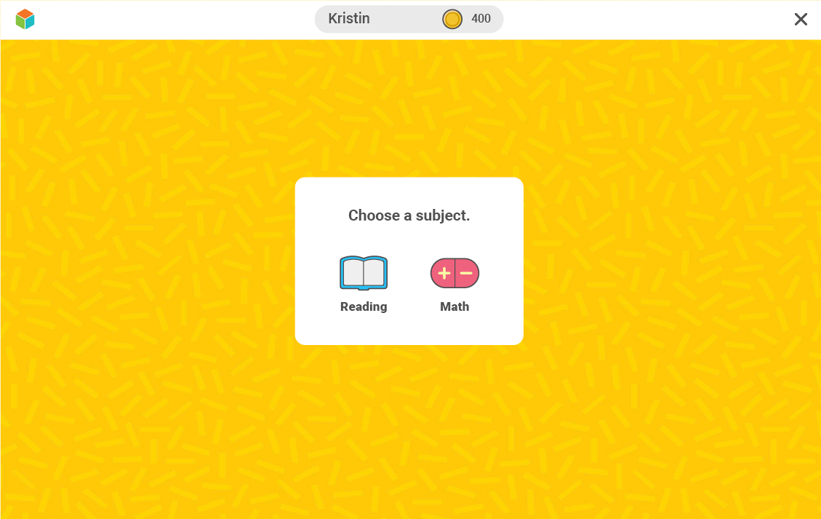
K–2 Student Dashboard
Notes:
Talking Points
When students log in to i-Ready, they will be prompted to choose a subject if they have Personalized Instruction for both Reading and Math. (If students only have one subject, they will be taken directly to the To Do screen.)
(Click) Then, they will be taken to the To Do screen on the student dashboard.
(Click) On the To Do screen, students can:
(Click) View Teacher-Assigned Lessons in the “Teacher Assigned” section if any lessons have been added.
(Click) If there are any Assignments that are past due, K–2 students can access them by selecting the down arrow.
(Click) View My Path i-Ready lessons after they have completed the Diagnostic, and if Personalized Instruction is turned on by the educator. (Click)
(Click) Select the My Progress Button. Students can:
See what they have recently completed and how they’ve performed on the Diagnostic and the lessons
See some key lesson stats including:
Lesson Time-on-Task this week
Lessons Passed this school year and their pass rate
Track their Lesson Streak indicating the greatest number of lessons they have passed in a row. (Click)
(Click) View Completed Work, which displays their completed lessons and scores and their Diagnostic scores.
(Click) Select the My Stuff Button. Students can:
Personalize their i-Ready experience by selecting a Buddy and a Theme
Use rewards earned by passing i-Ready lessons to play games of their choice

Slide 30
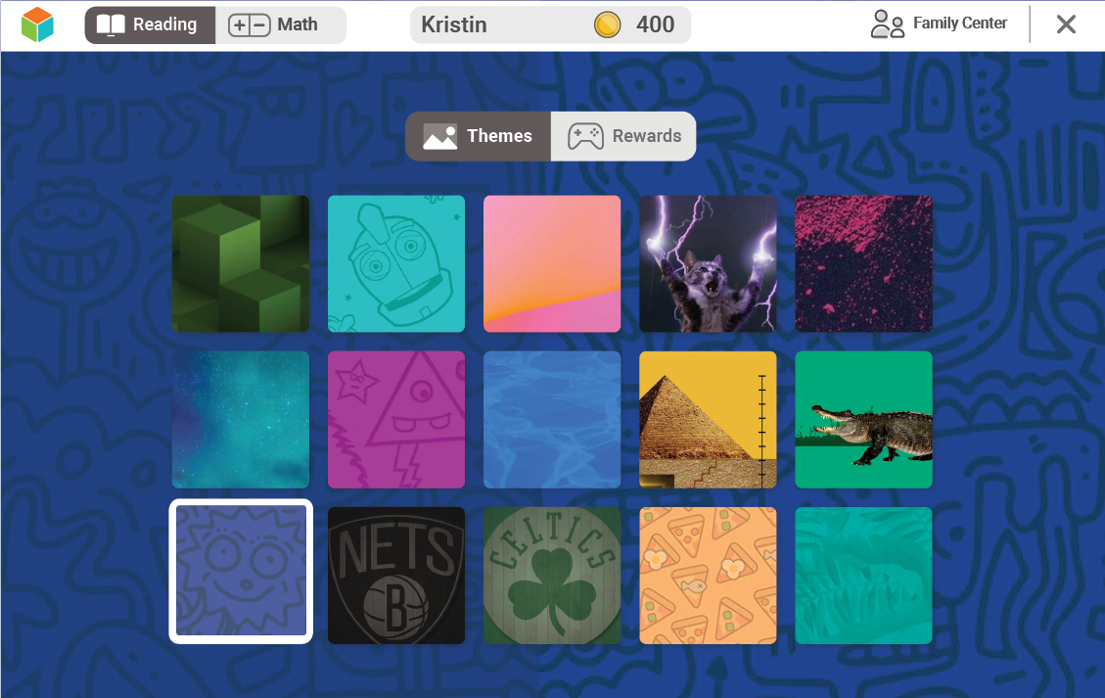
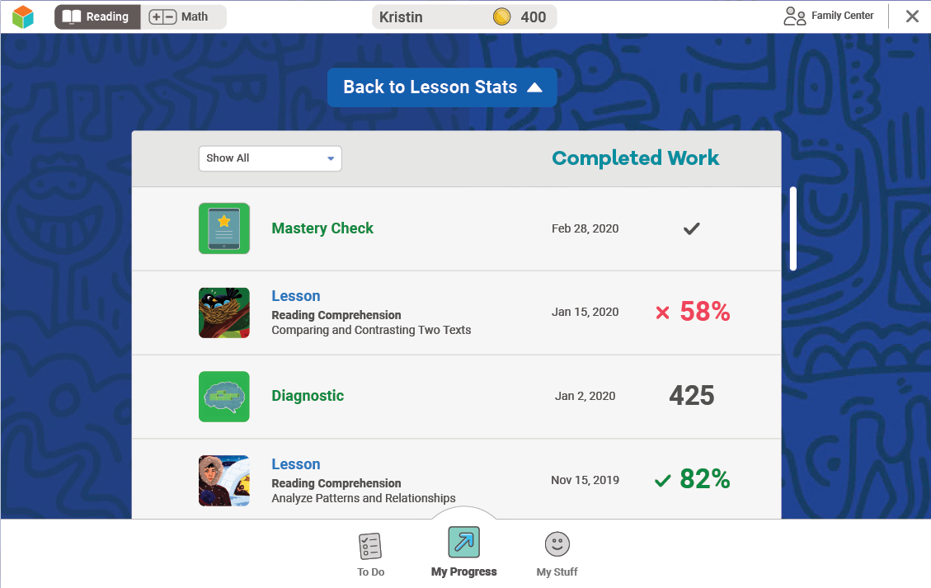
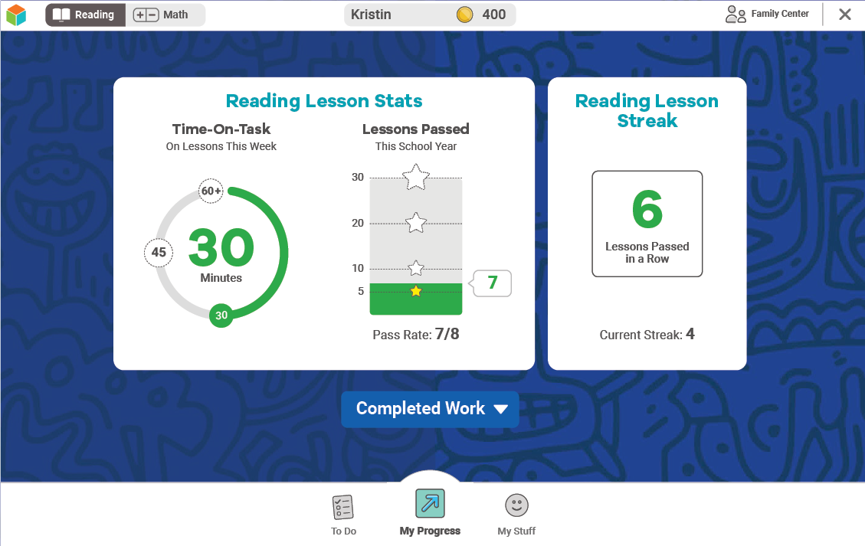
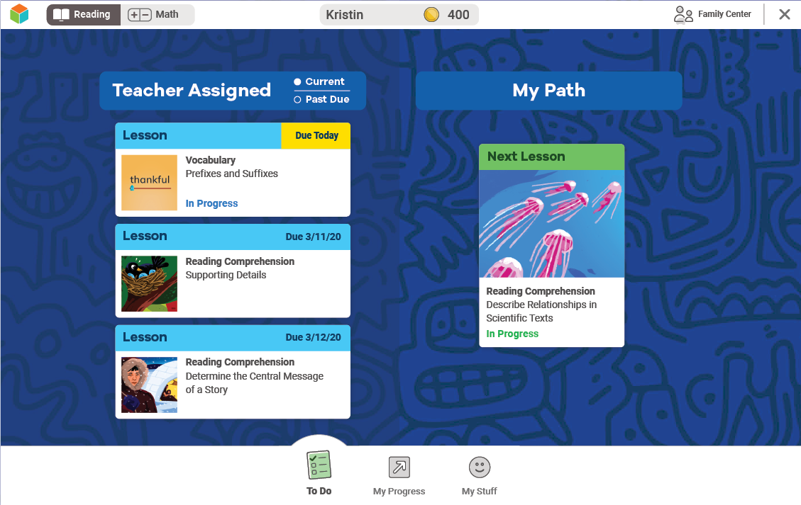
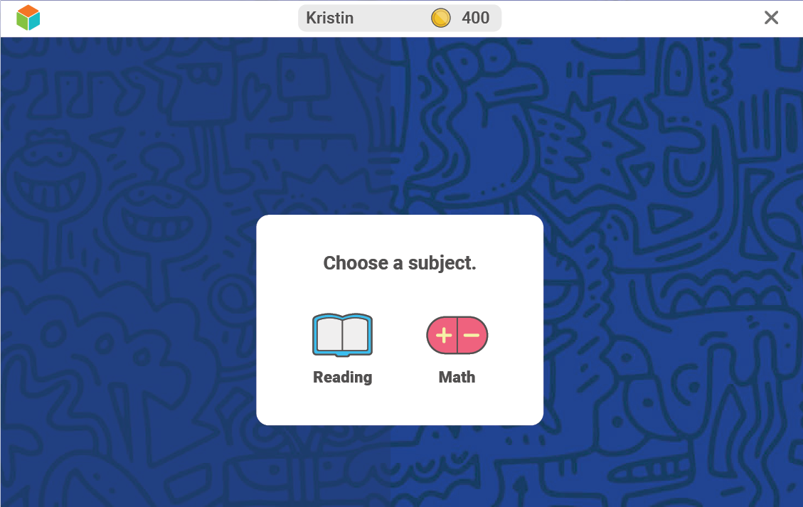
3–8 Student Dashboard
Notes:
Talking Points
When students log in to i-Ready, they will be prompted to choose a subject if they have Personalized Instruction for both Reading and Math. (If students only have one subject, they will be taken directly to the To Do screen.)
(Click) Then, they will be taken to the To Do screen on the student dashboard.
(Click) On the To Do screen, students can:
(Click) View Teacher-Assigned Lessons in the “Teacher Assigned” section if any lessons have been added.
(Click) If there are any Assignments that are past due, students can access them by selecting Past Due.
(Click) View My Path i-Ready lessons after they have completed the Diagnostic, and if Personalized Instruction is turned on by the educator.
These lessons are automatically assigned to students based on their Diagnostic results
They are specifically sequenced to move students toward grade level in all domains of Reading and Math so they can access and achieve grade-level standards
Students will get one lesson at a time under My Path, with the exception in Reading where students may see Close Reading in addition to the lesson. (Click)
(Click) Select the My Progress Button. Students can:
See what they have recently completed and how they’ve performed on the Diagnostic and the lessons
See some key lesson stats including:
Lesson Time-on-Task this week
Lesson Passed this school year and their pass rate
Track their Lesson Streak indicating the greatest number of lessons they have passed in a row.
View Completed Work, which displays their completed lessons and scores and their Diagnostic scores. (Click)
(Click) Select the My Stuff Button. Students can:
Personalize their i-Ready experience by selecting a Theme
Use rewards earned by passing i-Ready lessons to play games of their choice

Slide 31

Getting Support

Slide 32
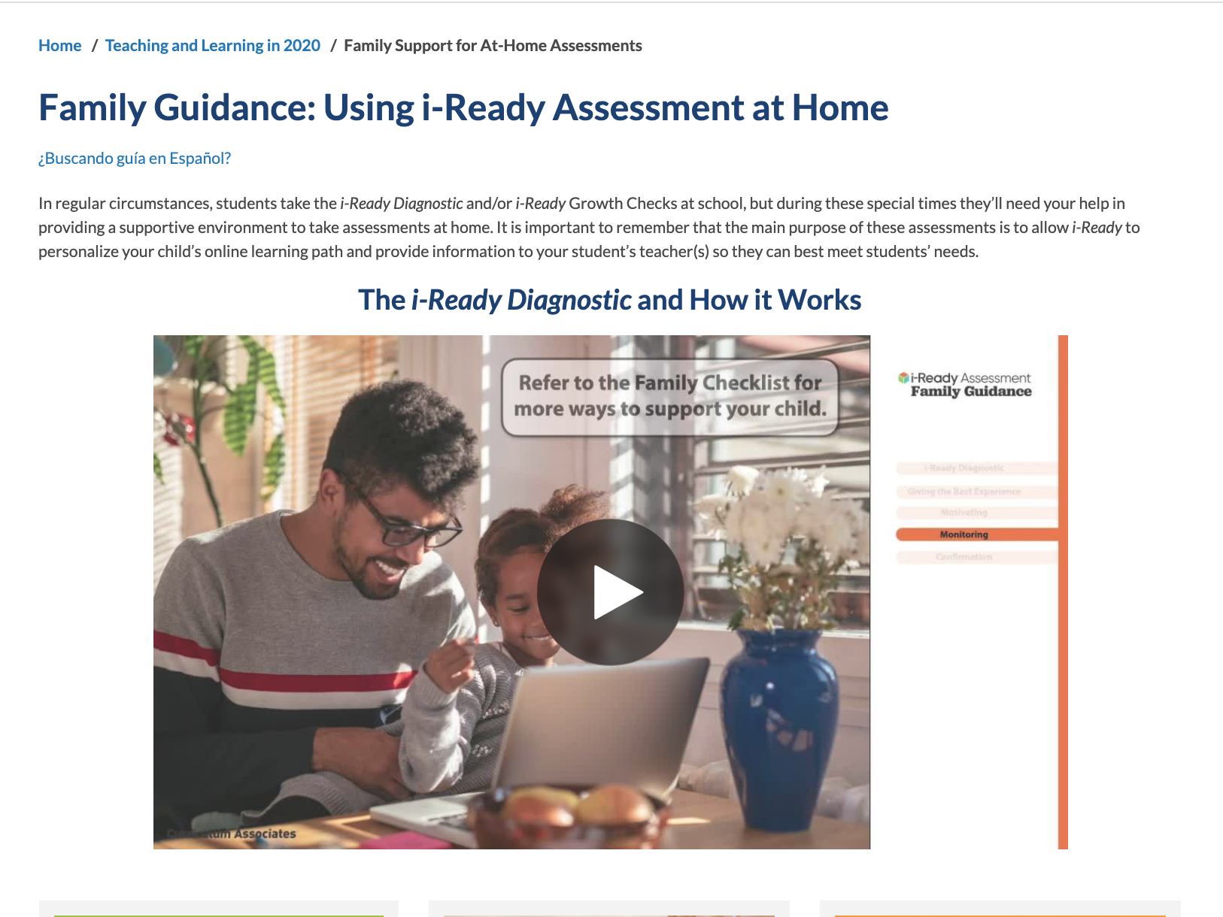
Administering the Diagnostic at Home
Notes:
Take families live:
https://www.curriculumassociates.com/teaching-learning-2020/home-assessment-family-support
Please also take families to the Family Center and point out the Family Guide: https://i-readycentral.com/familycenter/

Slide 33
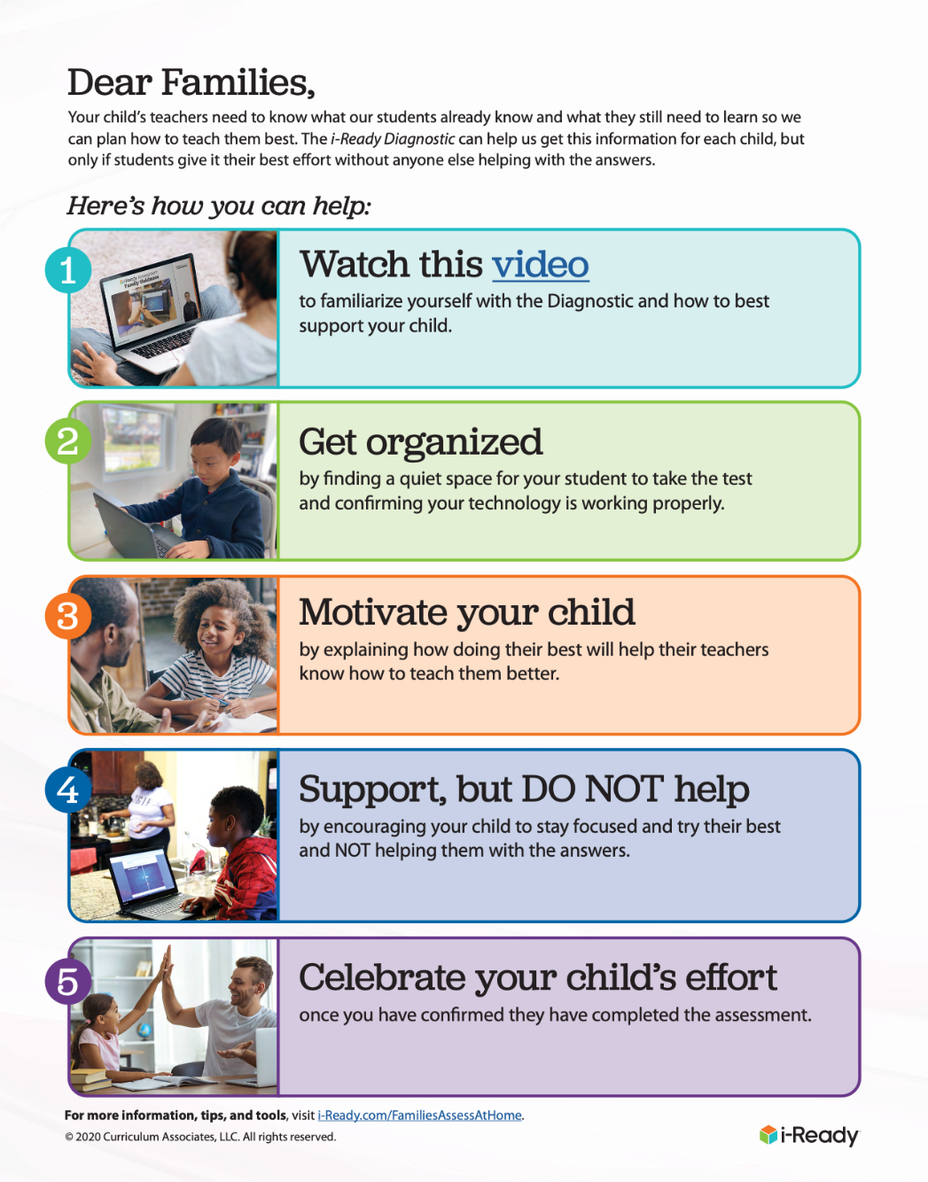
Administering the Diagnostic at Home
Notes:
Take families live to the family flyer and checklist
https://www.curriculumassociates.com/-/media/mainsite/files/i-ready/iready-administering-the-iready-diagnostic-at-home-during-a-school-closure-2020.pdf

Slide 34



Digital Readiness
Familiarize them to the computer or iPad
Practice with them
Make sure they feel comfortable navigating with the mouse or their finger
Notes:
For younger students, you might want to take a bit more time familiarizing them to the computer or iPad® they’ll be using, practice with them and make sure they feel comfortable navigating the page with the mouse or their finger.
Lots of great support for this can be found on the i-Ready Central® Digital Readiness page. Teachers can pull information and resources from this page to share with families: https://i-readycentral.com/articles/kcorner-digital-readiness/

Slide 35
Key Takeaways
The Diagnostic allows i-Ready to personalize your student’s online learning path and provides information to me so I can best meet students’ needs.
Help your student create a great testing environment but don’t help them on the assessment!
Check the dashboard to see how instruction is going.

Slide 36
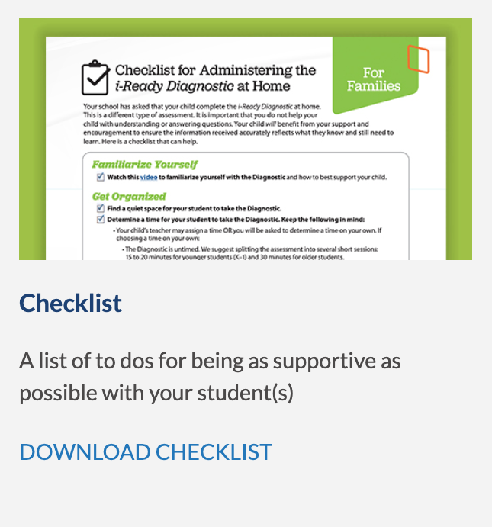
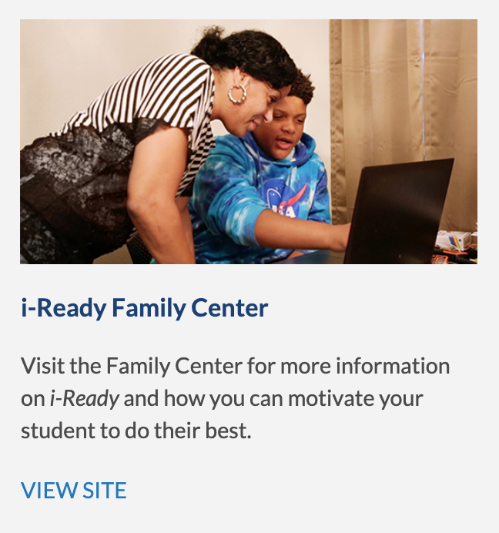
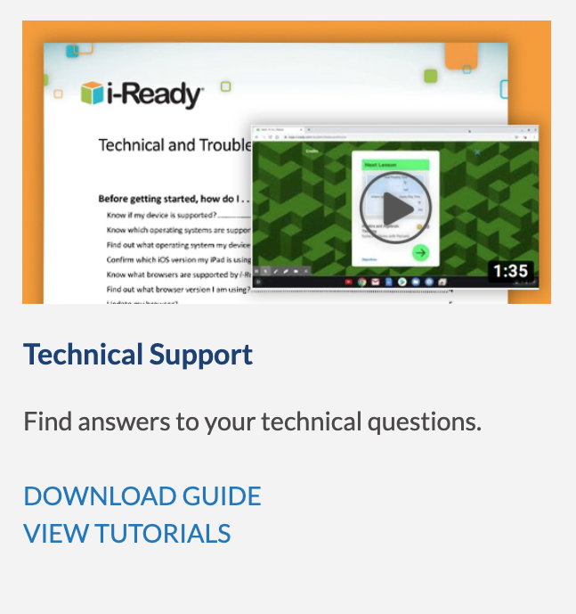
Getting Help
Notes:
Drop link to Family Center into chat: https://i-readycentral.com/familycenter/

Slide 37

Thank you!

